Slide 1

User Experience and User Interface Design
02: User Interface Design Basics
Dr. Seyed Reza Shahamiri More Info

Slide 2

User Interface Design
2
Users judge the quality of your app within the first 30 seconds!
A disproportionate amount of that judgement will be based not on the functionality, but on the visual aesthetics.
Does it look polished?
Does it look professional?
How easy is it to use?
More than just looking pretty, the entire user experience is critically important.

Slide 3
User Interface Design
3
Your app:
Should be fun to use.
Should surprise in delightful ways through subtle animations and smooth transitions that contribute to a feeling of power and effortlessness.
Should let users touch and interact with objects directly rather than having to use buttons and menus (if applicable).
Should use rich imagery and pictures in place of lots of words and long sentences.
Should allow users to customize your app, to make it theirs while providing beautiful and sensible defaults.

Slide 4
User Interface Design
4
You app must not never asks users for information that they've already provided.
Your app must provide simple shortcuts to complete complex tasks, and remember data settings and customizations making them available across every device.

Slide 5
User Interface Design
5
A user interface is the part of the system with which the users interact.
It includes:
the screen displays that provide navigation through the system,
the screens and forms that capture data,
and the reports that the system produces (whether on paper, on the screen, or via some other media).
Interface design is the process of deﬁning how a system will interact with external entities (e.g., customers, suppliers, other systems).

Slide 6
User Interface Design Parts
6
The user interface includes three fundamental parts:
Navigation mechanism: the way in which the user gives instructions to the system and tells it what to do (e.g., buttons, menus).
Input mechanism: the way in which the system captures information (e.g., forms for adding new customers).
Output mechanism: the way in which the system provides information to the user or to other systems (e.g., reports, Web pages).
Each of these is conceptually different, but they are closely intertwined.

Slide 7
User Interface Design Principles 1. Layout
7
The first element of design is the basic layout of the screen, form, or report.
Most software designed for personal computers follows the standard Windows or Macintosh approach for screen design.
The screen is usually divided into three boxes. The top box is the navigation area, through which the user issues commands to navigate through the system. The bottom box is the status area, which displays information about what the user is doing. The middle—and largest—box is used to display reports and present forms for data entry.

Slide 8

Navigation
8
Content
Footer

Slide 9
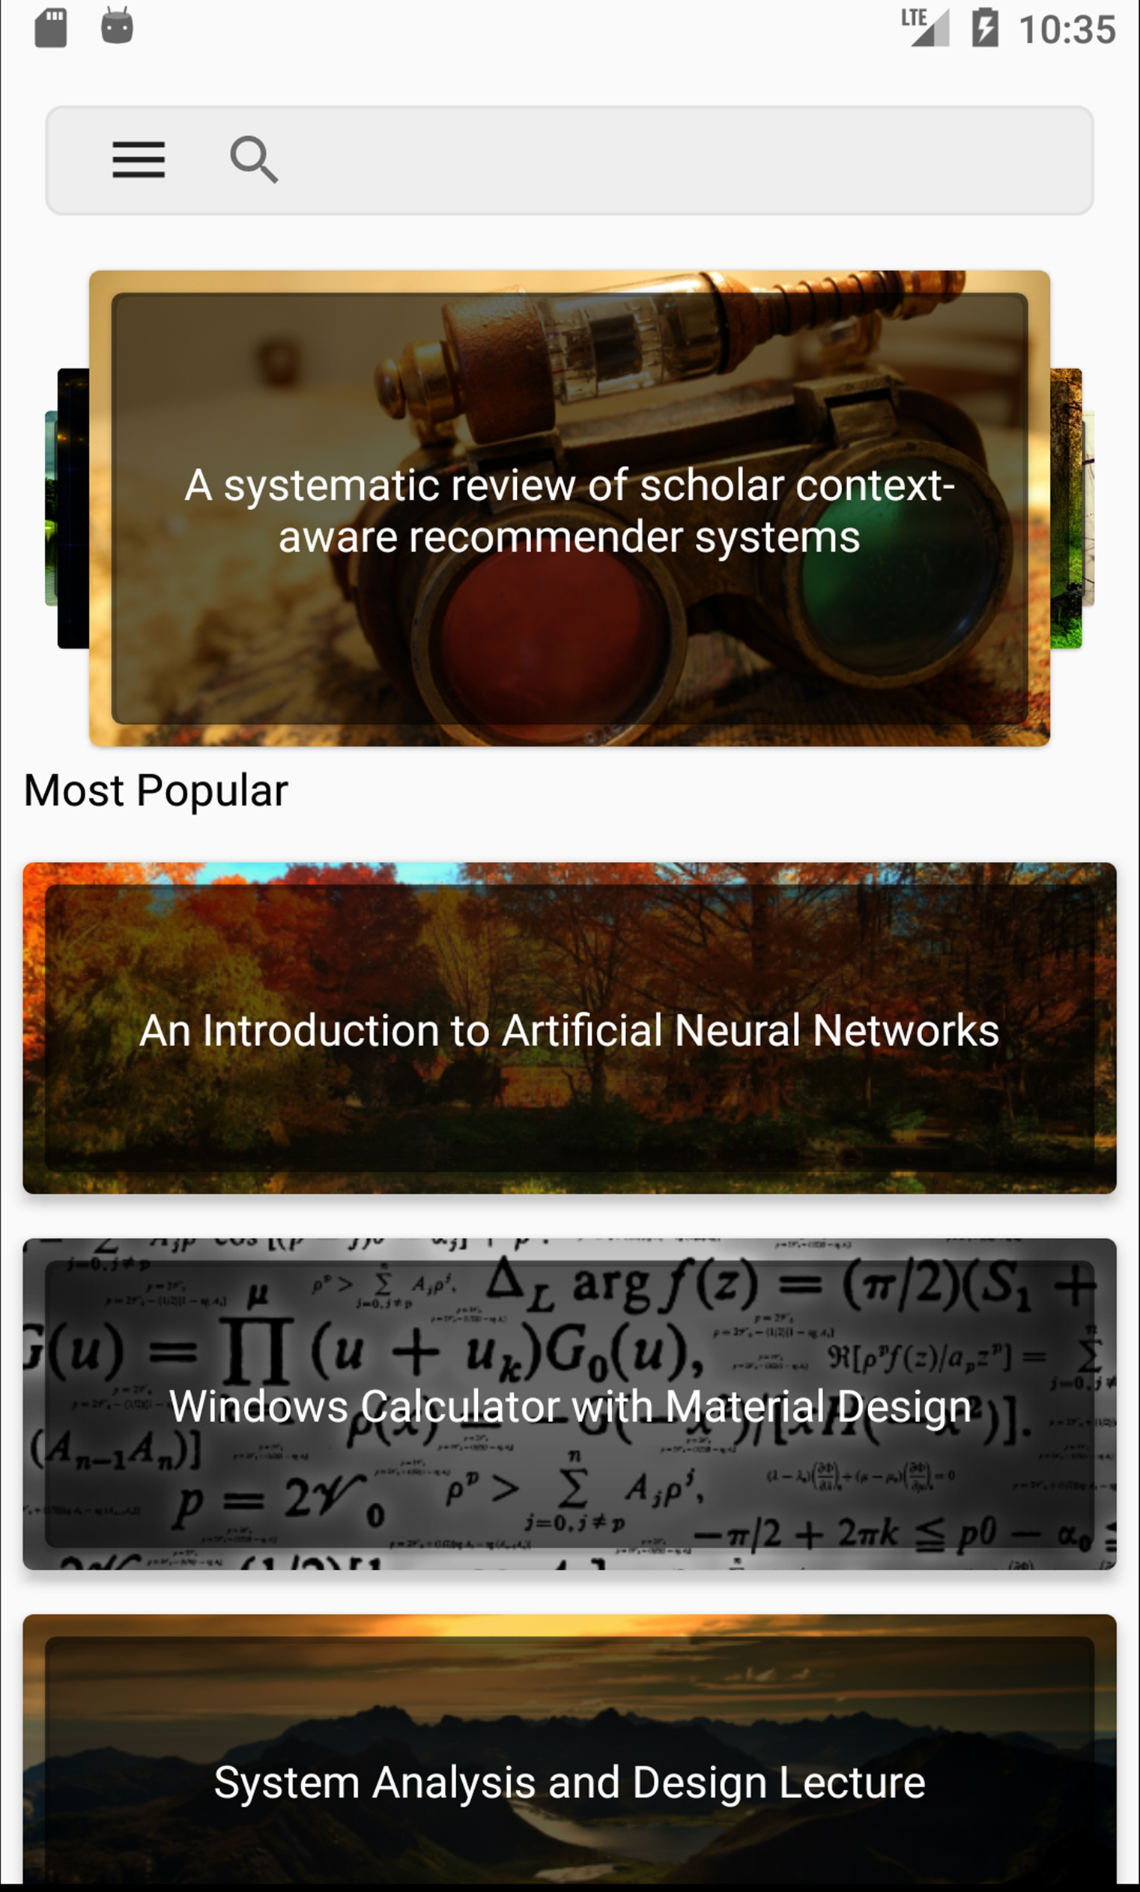
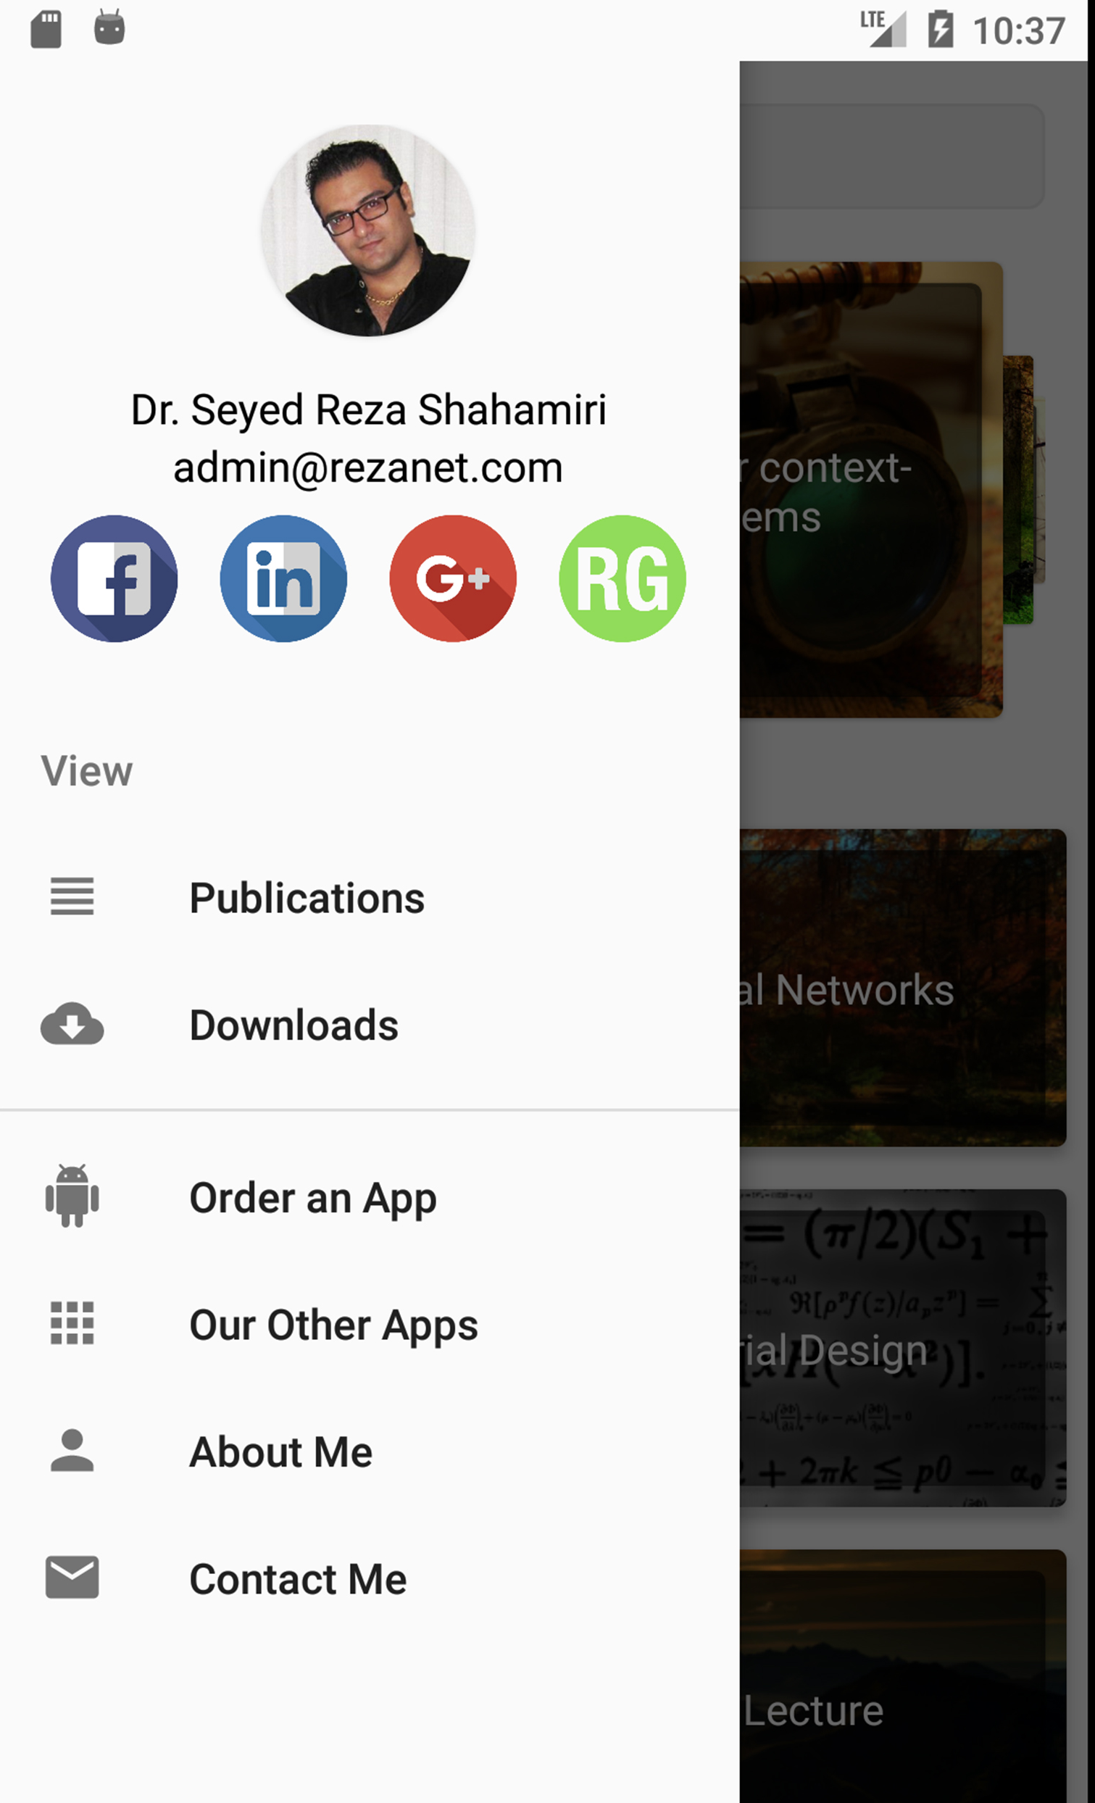
9

Slide 10
User Interface Design Principles 2. Content Awareness
10
Content awareness refers to the ability of an interface to make the user aware of the information it contains with the least amount of effort on the user’s part.
Users should always be aware of where they are in the system and what information is being displayed.

Slide 11
User Interface Design Principles 3. Aesthetics
11
Aesthetics refers to designing interfaces that are pleasing to the eye.
Interfaces do not have to be works of art, but they do need to be functional and inviting to use.
In most cases, less is more, meaning that a simple, minimalist design is the best.
Interfaces should be functional and inviting to users through careful use of white space, colours, and fonts.
There is often a trade-off between including enough white space to make the interface look pleasing without losing so much space that important information does not fit on the screen.

Slide 12
User Interface Design Principles 4. User Experience (UX)
12
Although ease of use and ease of learning often lead to similar design decisions, there is sometimes a trade-off between the two.
Novice users or infrequent users of software will prefer ease of learning, whereas frequent users will prefer ease of use.

Slide 13
User Interface Design Principles 5. Consistency
13
Consistency in interface design enables users to predict what will happen before they perform a function.
It is one of the most important elements in ease of learning, ease of use, and aesthetics.

Slide 14
User Interface Design Principles 6. Minimal User Effort
14
The interface should be simple to use.
Most designers plan on having no more than three mouse clicks from the starting menu until users perform work.

Slide 15
User Interface Design Schneiderman's 8 Golden Rules
15
Strive for consistency.
Give shortcuts to the user.
Offer informative feedback.
Make each interaction with the user yield a result.
Offer simple error handling.
Permit easy undo of actions.
Let the user be in control.
Reduce short-term memory load on the user.

Slide 16
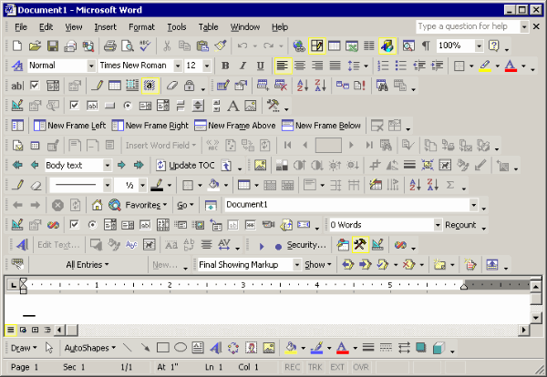
User Interface Design
16

Slide 17
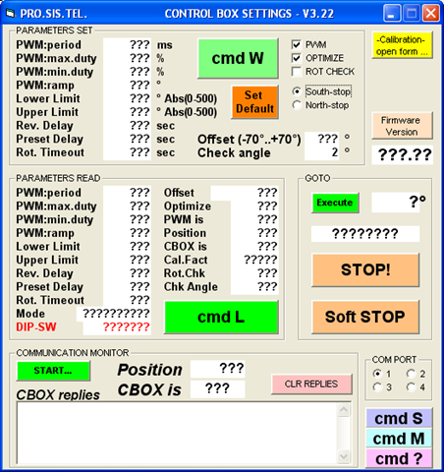
User Interface Design
17

Slide 18
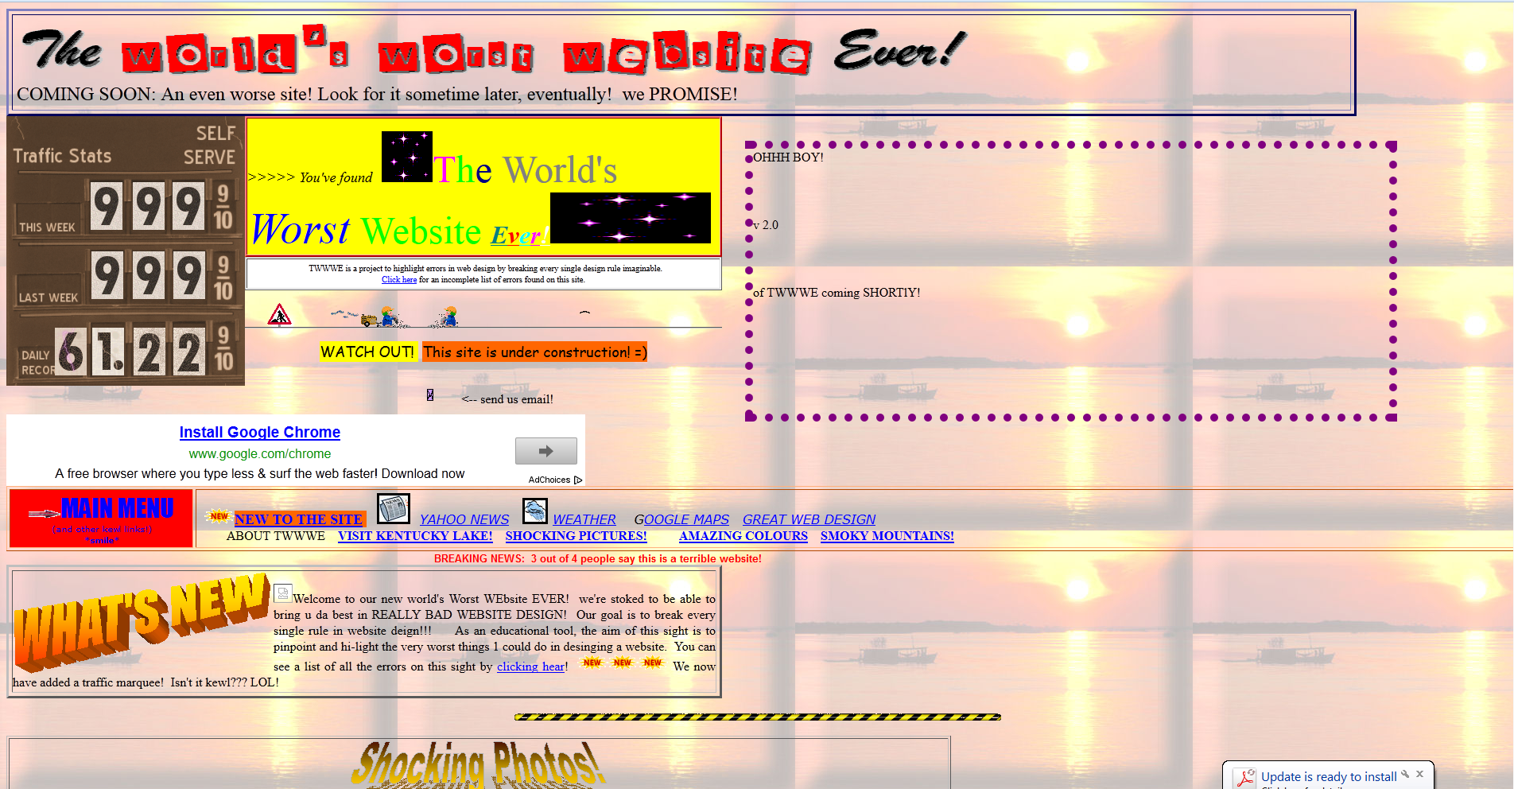
User Interface Design
18

Slide 19
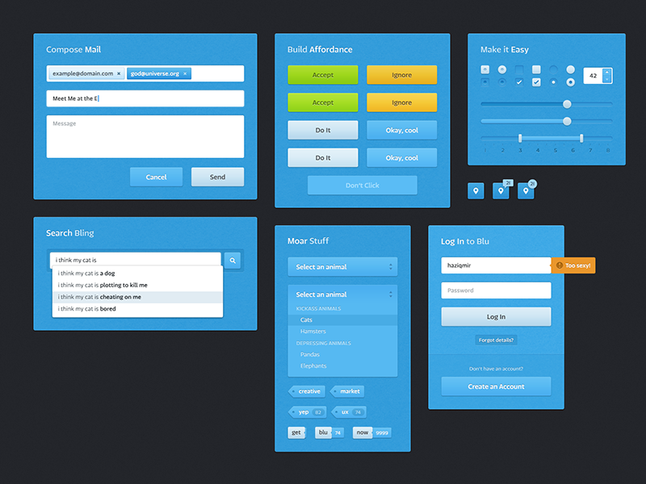
User Interface Design
19

Slide 20
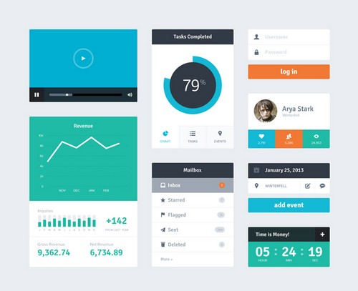
User Interface Design
20

Slide 21
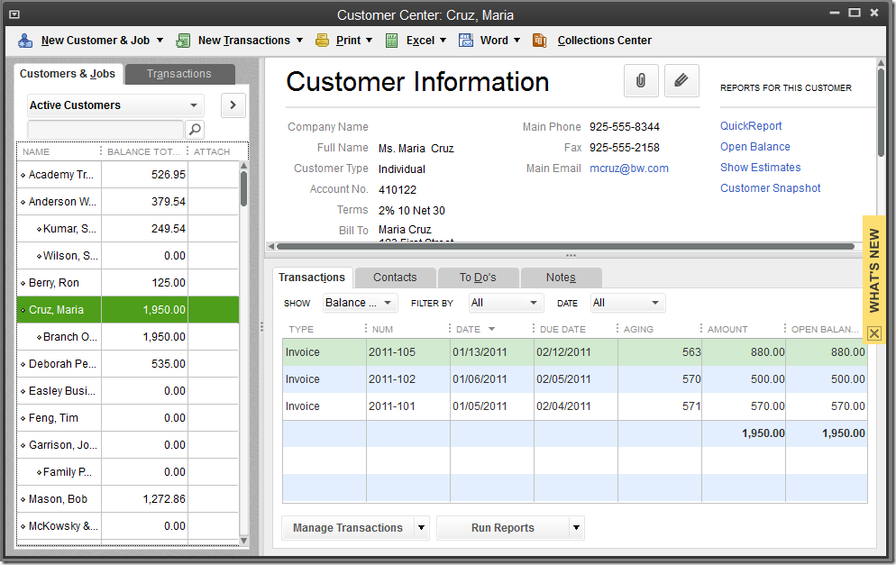
User Interface Design
21

Slide 22
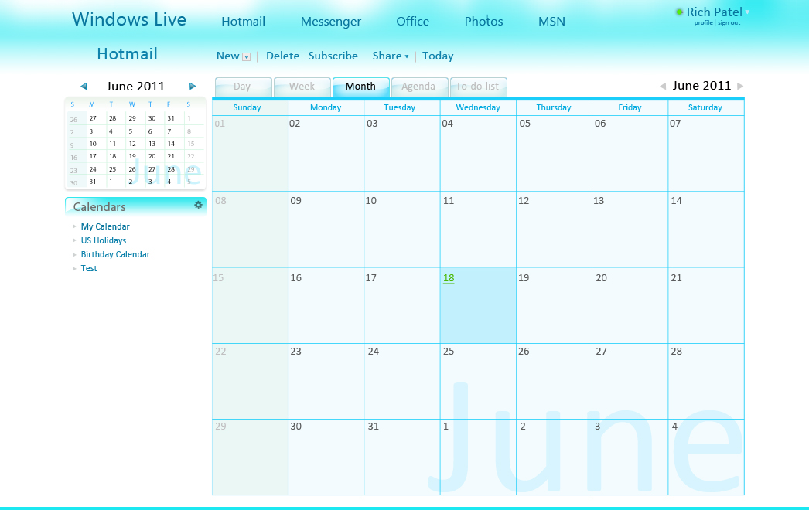
User Interface Design
22

Slide 23
User Interface Design
23

